Slide 2

Remember to write Titles, Objectives, dates and underline with a ruler!
This means that you will need to make notes in your exercise book.
This means that this is the section that you will need to make notes on
© Pearson Education Ltd 2020. Copying permitted for purchasing institution only.

Slide 3

Learning objectives
In this lesson you will learn to:
  use string indexing
  use string manipulation functions.
For more information on this topic, and additional student activities, see Topic 1.3 of the student book.
© Pearson Education Ltd 2020. Copying permitted for purchasing institution only.
Notes:
Specification content: 1.2.2 1.2.5 6.2.2 6.3.1 6.3.3, 6.6.1

Slide 4
Strings
Strings are sequences of characters.
They can contain any standard keyboard character (letters, numbers, and punctuation marks).
In Python, you declare strings by placing “ “ or ‘ ‘ around the text.
You can work with strings in a number of ways, including printing them to the screen, as in this example.
aStringExample = "Computer Science"
print(aStringExample)
© Pearson Education Ltd 2020. Copying permitted for purchasing institution only.

Slide 5
String indexing
As strings are sequences of characters, you can treat each of the characters separately using the index of the character.
Indices are the position of the character within the string, starting from 0.
Let’s use the example below to look at how this works.
You can use the indices to access individual characters and groups of characters.
Index | 0 | 1 | 2 | 3 | 4 | 5 | 6 | 7 | 8 | 9 | 10 | 11 | 12 | 13 | 14 | 15
Character | C | o | m | p | u | t | e | r |  | S | c | i | e | n | c | e
Notice that the space counts as a character. Don’t miss them out as it will misalign your indices.
© Pearson Education Ltd 2020. Copying permitted for purchasing institution only.

Slide 6
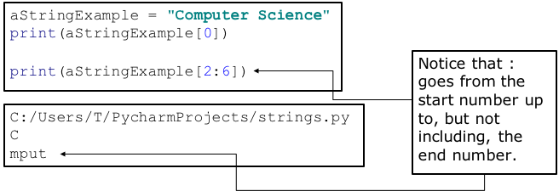
String indexing
© Pearson Education Ltd 2020. Copying permitted for purchasing institution only.
Notes:
Student Activity 1

Slide 7
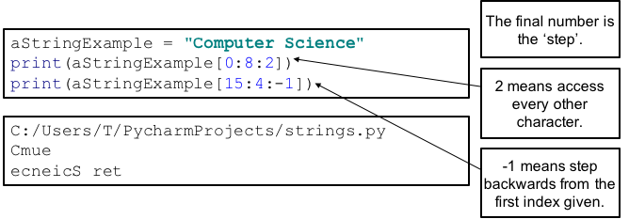
String slices
You’ve seen how to access individual and small groups of characters from a string.
You can use the [ ] to access selections of characters and even change the direction of access.
© Pearson Education Ltd 2020. Copying permitted for purchasing institution only.
Notes:
Student Activity 2

Slide 8
Concatenation
You can also join strings together using the + operator.
firstString = "str"
secondString = "ing"
finalString = firstString + secondString
print(firstString)
print(secondString)
print(finalString)
str
ing
string
© Pearson Education Ltd 2020. Copying permitted for purchasing institution only.

Slide 9
Library functions
You can manipulate strings extensively using library functions.
These are small programs written by others and compiled into libraries.
Programmers use library functions to quickly add functionality to their programs, without having to write, rewrite, or debug the code themselves.
In industry, developers use libraries for a huge variety of applications. They often create their own libraries for others to use.
There are a number of Python library functions that you can use to work with strings.
© Pearson Education Ltd 2020. Copying permitted for purchasing institution only.

Slide 10
Python string library functions
There are lots of functions you can use that are built into Python. You can find out more about these using the Python Documentation online.
We will look a few of the most common and useful ones.
Function | What does it do?
len(string) | Returns the number of characters in the string.
<str>.isalpha() | Checks that every character in the string is a letter or a number.
<str>.lower() | Makes all the letters in the string lower case.
<str>.upper() | Makes all the letters in the string upper case.
<str>.rjust(width) | Moves the text to the right in a new string of a given width. The default fill character is a space.
<str>.center(width) | Centres text in a string of a given width. The default fill character is a space. Notice the American spelling here.
© Pearson Education Ltd 2020. Copying permitted for purchasing institution only.
Notes:
https://docs.python.org/3/library/string.html

Slide 11
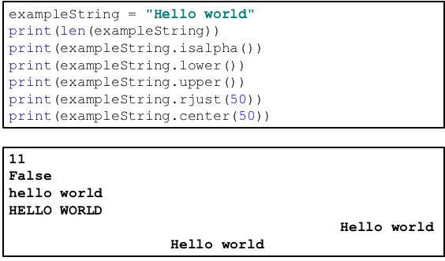
In action
© Pearson Education Ltd 2020. Copying permitted for purchasing institution only.
Notes:
Student Activity 3

Slide 12
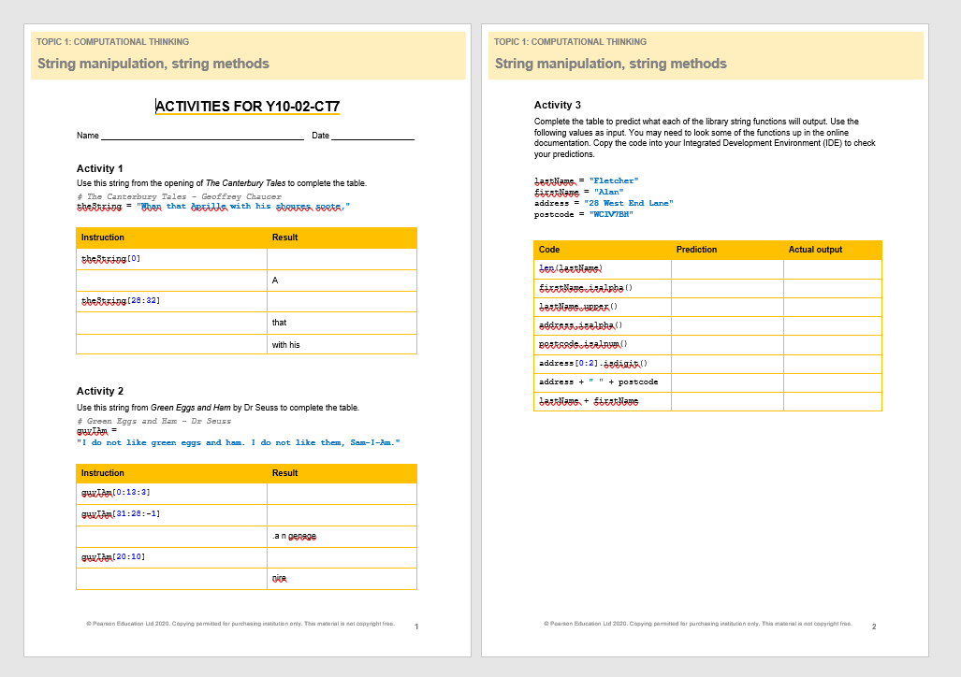
Task - complete the Activities worksheet
Make sure that you write out the 3 tables in your books and complete them by hand. Use a ruler when drawing lines!
© Pearson Education Ltd 2020. Copying permitted for purchasing institution only.

Slide 13
Wrap up, you have learned how to . . .
Use string indexing.
  Use the square brackets [ ] to access individual or groups of characters from a string.
Use string manipulation functions.
  Such as length, isalpha, lower, upper, etc.
© Pearson Education Ltd 2020. Copying permitted for purchasing institution only.

